Slide 1
Production System
Fermentation
Enzyme Technology
Bioconversion (Biotransformation)

Slide 2
Classification of fermentation
The term “fermentation” used in microbial physiology or industrial microbiology
Cell cultivation (fermentation) or biocatalyst (biotransformation, enzyme technology)
Type I, II, III, or mixed
Aseptic or non-aseptic: pure culture, inoculum; or mixed culture, development of indigenous MOs
Solid substrate or liquid media
Suspended mode or supported mode: surface or submerged cultivation
Batch, fed-batch, or continuous

Slide 3
Overview of the fermentation process
Definition: The cultivation of microorganisms under optimal conditions for the production of desired products
Advantage: versatile
Disadvantage: (1)complex and / or expensive nutrients are required; (2)the waste of nutrients for the growth of cells; (3)capital and running costs are high, especially when high rates of aeration and sterile conditions are required; (4)may be difficult for continuous operation; (5)significant batch to batch variations; (6)isolation of product is often difficult and expensive; (7)serious environmental problems

Slide 4
Overview of the enzyme technology
Definition: the use of enzyme as the catalyst of chemical reactions
Advantage:
In comparison with chemosynthesis: (1)mild condi-tions; (2)labile reactions; (3)less energy requirement ; (4)high degrees of conversion; (5)less pollutants; (6)specific reaction
In comparison with fermentation: (1)less susceptible to microbial contamination; (2)easy isolation of products; (3)higher yield and quality of the product; (4)continuous use or reuse in batch operations
Disadvantage:
In comparison with chemosynthesis: (1)more labile catalyst; (2)complex requirements such as cofactors
In comparison with fermentation: not suitable for complex reactions

Slide 5
Overview of the bioconversion process
Definition: The use of biological catalysts for the selective modification of defined pure compounds into defined final products
Bioconversion / Microbial transformation
Biological catalysts used in the bioconversion: include spores, growing cultures, resting cells, organells, or enzymes. These catalysts may or may not be immobilized.
Advantage & Disadvantage: the same as those of enzyme technology

Slide 6
Classification of fermentation according to the dependence of product formation on energy metabolism (in batch culture)
Type I
Type II
Type III

Slide 7
Type I fermentation
The product is derived directly from the primary metabolism used for energy production
Growth, carbohydrate catabolism, and product formation run almost in parallel
Trophophase (the logarithmic growth phase) and idiophase (the subsequent phase) are not separated from each other
Processes for the production of single-cell protein, ethanol, and gluconic acid

Slide 8
Type II fermentation
The product is also derived from the substrate used for primary energy metabolism, but production takes place in a secondary pathway which is separate from primary metabolism
There are two maxima in batch fermentation. At first, good growth and high substrate consumption but little or no product formation. Then growth slows down and product formation begins, accompanied by a high substrate consumption
Trophophase and idiophase are separated in time
Citric acid, itaconic acid, and some amino acids

Slide 9
Type III fermentation
The product is not derived from catabolism, but from amphibolic pathways (by the reactions of intermediary metabolism)
Primary metabolism and product formation occur at completely separate times
Secondary metabolites are sometimes referred to as idiolites
Many antibiotics and vitamines
The correlation of mycelium production and changes in mycelium structure with antibiotic production is complex

Slide 10
Stages in oxytetracycline fermentation with Streptomyces rimosus
Lag phase: 90 min for low inoculum, no metabolism evident
Growth of primary mycelium: 10-25 h depending on inoculum, hyphae dense, no antibiotic production
Fragmentation of primary mycelium: 10 h, no growth
Growth of secondary mycelium: 25 h, mycelium volume is 2 to 4 times that of stage 2, hyphae thin, good antibiotic production
Stationary phase: growth ceases, metabolism is low, antibiotic production continuous but at a low rate

Slide 11
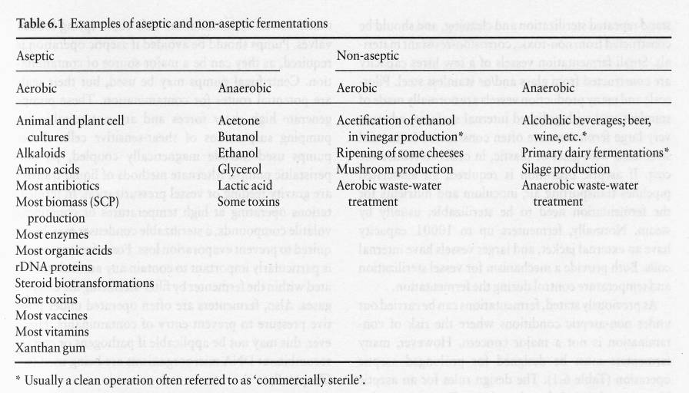
Aseptic or non-aseptic fermentations

Slide 12
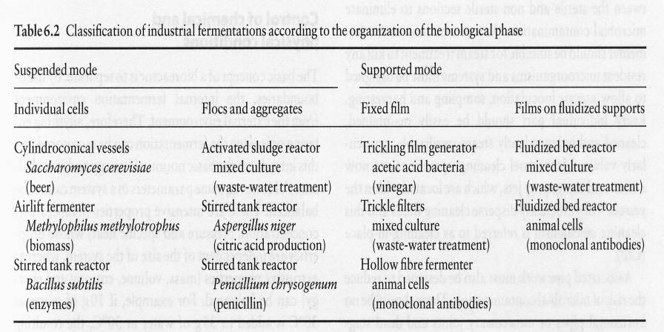
Classification of fermentation according to the organization of the biological phase

Slide 13
Solid-state fermentation
Definition: Microbial growth and product formation occur on solid, normally organic, materials.
Examples: (1) soil growth, (2) surface culture, (3) composting and silage making, (4) wood rotting, (5) mushroom cultivation, (6) production of familiar Western foods, e.g. bread, mold-ripened cheese, and sausage, (7) production of traditional Oriental foods, e.g. tempeh, sufu etc., (8) production of industrial enzymes, organic acids, etc.
Substrates: cereal grains, bran, legumes and lignocellulosic materials, such as straw, wood chipping, etc.

Slide 14
Classification of solid-state fermentation: according to the physical state of the substrate
(1)Low-moisture solids: without agitation, e.g. tempeh and natto; with occasional stirring, e.g. miso and soy sauce; with continuous agitation, e.g. aflatoxin
(2)Suspended solids: in packed columns through which liquid is circulated; in stationary or agitated liquid media

Slide 15
Classification of solid-state fermentation: according to the nutritional state of the substrate
The solid is the major nutrient source (most processes)
The solid is nutritionally inert (uncommon)

Slide 16
Classification of solid-state fermentation: according to the inoculants
(1)Monoculture: as in mushroom production, e.g. Agaricus bisporus
(2)Dual cultures: e.g. straw bioconversion using Chartomium cellulilyticum and Candida tropicalis
(3)Mixed cultures: as in composting, where the microorganisms may be indigenous or added mixed starter cultures (inoculants)

Slide 17
Advantages of solid-state fermentation
Low-cost media / Simple technology / Low capital costs / Reduced energy requirements / Low waste-water output
Higher and reproducible product yields / Concentrated substrate / Smaller fermentation vessels
Seed tanks are unnecessary, and spore inocula may be used
Low moisture reduces the problem of contamination
Conditions for fungal growth are similar to those in natural habitats
Can be used to provide low-shear environments for shear-sensitive mycelial organisms
Products may be incorporated directly into animal feeds

Slide 18
Disadvantages of solid-state fermentation
Slower microbial growth
Problems with heat build-up
Continuous agitation or rotation may involve high power requirements
The addition of water in early fermentation stages may increase the risk of bacterial contamination
Difficult scale-up and considerable developmental work
Difficult control of the environment within the bioreactors, particularly the simultaneous maintenance of optimal temperature and moisture
Agricultural substrates may require some kind of mechanical, chemical or biological pretreatment processing

Slide 19
Operation modes of fermentation
Batch culture
Fed-batch culture
Continuous culture

Slide 20
Batch culture
There are no additions following inoculation, apart from acid or alkali for pH control and input of air for aerobic fermentation
There is a definite beginning and end to the process
Loading / Sterilization / Inoculation / Growth of the organism / Product harvesting / Cleaning
Examples of this mode of operation: alcoholic beverages, most amino acids, enzymes, organic acids, etc.

Slide 21
Special considerations in operating batch culture
The physiological condition of the inoculum (log phase is usually better)
The concentration of the inoculum: effects include change in pH value, increase in supply of nutrients, decrease of growth inhibitors, diffusion of essential cofactors out of cells

Slide 22
Advantages & disadvantages of batch culture
Initial capital expenditure is lower
Relatively simple to terminate a contaminated fermentation and restart a new cycle
Less effective for the production of biomass and primary metabolites / a considerable lag period and non-productive down-time, involving cleaning, refilling, sterilizing, post-sterilization cooling
Batch-to-batch variability
Greater stress on instruments and probes by increased frequency of sterilization
Greater running costs for preparing and maintaining stock cultures
Generally more personnel are required

Slide 23
Fed-batch culture
Batch culture supplied in small doses with fresh nutrients (growth-limiting substrates) or additives (precursors to products)
History: (1)Early 1900s, Saccharomyces cerevisiae (baker’s yeast), with malt as a substrate / (2)Early 1940s, glycerol, butanol, acetone, organic acids with higher product yields and more efficient utilization of medium constituents / (3)More recent years, antibiotics (e.g. penicillin G), vitamins, amino acids, enzymes, and growth hormones.
Continuous or intermittent additions, or a single supplementation (often the end of the rapid growth phase)
Fed-batch with recycle of cells (biomass): for some specific purposes, e.g. some ethanol fermentations and waste-water treatment processes

Slide 24
Control the feeding process in fed-batch culture
It is usually not possible to measure the substrate concentration directly and continuously during the fermentation (on-line)
Indirect parameters have to be measured, e.g. pH, pO₂, CO₂-content in the exhaust air

Slide 25
Advantages of Fed-batch culture
Processes suffered from substrate inhibition, catabolite repression, or substrate caused viscosity problems
Production of growth-associated products: increase the production of biomass
Production of secondary metabolites: control feed rate (1)to initially produce high biomass then, as the organism enters stationary phase and growth slows down (2)to finally give just enough substrate for maintenance energy whilst product formation is taking place
Reduce broth viscosity as in the production of dextran and xanthan gum
Overcome problems found in continuous culture: contamination, mutation and plasmid instability

Slide 26
Disadvantages of Fed-batch culture
Additional instruments for feedback control may be costly (compare with batch culture)
In systems without feedback control, where the feed is added on a pre-determined fixed schedule, it is difficult to deal with any deviations in the organisms growth pattern (i.e. time courses may not always follow expected profiles)
Requires a substantial amount of operator skill

Slide 27
Continuous culture
A method of prolonging the exponential growth phase of an organism in batch culture.
Feeding fresh nutrients and removing spent medium plus cells from the system / several factors remain constant with time (steady state), i.e. culture volume, cell concentration, product concentration, and culture environment (e.g. pH, temperature, dissolved oxygen)
Particularly well suited for the production of biomass and growth-associated primary metabolites.
Have been used on an industrial scale for over 50 years / vinegar production and waste treatment, such as the trickling filter and activated sludge processes.
Laboratory-scale continuous culture is a useful tool for studying the growth and physiology of microorganisms.

Slide 28
Types of continuous culture
In homogeneously mixed bioreactor: chemostat, turbidostat
In plug flow reactor: at the entrance to the reactor, cells must continuously be added along with nutrient solution, e.g. back flow from the fermentor outlet or from a second continuous fermentation

Slide 29
Kinetics of chemostat
Monod equation: μ=μ_{m}〔S / (K_{s} ＋ S) 〕
Dilution rate: D = F / V = μ
Determination of cell density X and substrate concentration S X = Y〔S_{o} － (D．K_{s}) / (μ_{m}－ D)〕= Y (S_{o}－ S) S = (D．K_{s}) / (μ_{m}－ D)
Actual behavior of the chemostat C-limited: very low, very high dilution rate N-limited: low dilution rate
There are differences in metabolism at a constant flow rate depending on the substrate limitation

Slide 30
Advantages & disadvantages of continuous culture
In theory, more productive than batch systems
Cell mass and other products can be produced under optimal environment conditions.
Significantly more productive in terms of fermentor down-time per unit of product manufactured than batch or fed-batch (for fast-growing microorganisms).
Lower operating costs
Higher initial capital expenditure
To date, relatively few large-scale industrial examples have become established, other than for biomass, fuel/industrial ethanol (or beer) and effluent treatment

Slide 31
Problems associated with continuous culture: for industrial use the system must be stable for at least 500 to 1000 hr, problems include
Contamination: maintaining sterile conditions on an industrial scale over a long period of time
Genetic instability: Spontaneous mutation or reverse mutation / Plasmid instability
Variation of the composition of industrial nutrient solution

Slide 32
問題
相對於醱酵製程(fermentation process)而言，使用固定化酵素或固定化菌體的生物轉化製程(bioconversion process)有哪些優點？
某研究人員在探討利用嗜熱真菌(thermophilic fungi)生產纖維素分解酵素的研究時，決定採用固態醱酵 (solid-state fermentation)的程序。試問其可能的考慮因素為何？
下列名詞的內涵：Fed-batch cultivation, Idiolites, Trophophase, Type I fermentation, Solid-state fermentation, Submerged fermentation, Non-productive fermentor down-time

